Slide 1
NATURAL LANGUAGE PROCESSING

Slide 2
NLP
 | import nltk nltk.download() from nltk.book import * text1.concordance("monstrous") A concordance view shows us every occurrence of a given word, together with some context text1.similar("monstrous") We can find out by appending the term similar to the name of the text text2.common_contexts(["monstrous", "very"]) The term common_contexts allows us to examine just the contexts that are shared by two or more words

Slide 3
text4.dispersion_plot(["citizens", "democracy", "freedom", "duties", "America"])
It is one thing to automatically detect that a particular word occurs in a text, and to display some words that appear in the same context. However, we can also determine the location of a word in the text: how many words from the beginning it appears. This positional information can be displayed using a dispersion plot
text3.generate()
generating some random text in the various styles
sorted(set(text3))

Slide 4
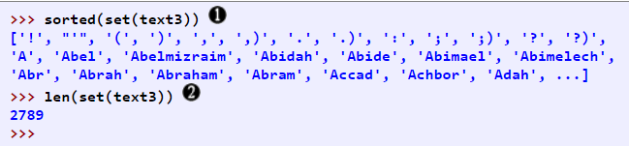

By wrapping sorted() around the Python expression set(text3) , we obtain a sorted list of vocabulary items, beginning with various punctuation symbols and continuing with words starting with A. All capitalized words precede lowercase words. We discover the size of the vocabulary indirectly, by asking for the number of items in the set, and again we can use len to obtain this number . Although it has 44,764 tokens, this book has only 2,789 distinct words, or "word types." A word type is the form or spelling of the word independently of its specific occurrences in a text — that is, the word considered as a unique item of vocabulary. Our count of 2,789 items will include punctuation symbols, so we will generally call these unique items types instead of word types

Slide 5
lexical diversity’ is a measurement of how many different lexical words there are in a text. Lexical words are words such as nouns, adjectives, verbs, and adverbs that convey meaning in a text.
lexical_diversity() and percentage() are the names for specific blocks of code, we can go ahead and use these functions

Slide 6
Collocations and Bigrams
A collocation is a sequence of words that occur together unusually often. Thus red wine is a collocation, whereas the wine is not. A characteristic of collocations is that they are resistant to substitution with words that have similar senses; for example, maroon wine sounds definitely odd.
To get a handle on collocations, we start off by extracting from a text a list of word pairs, also known as bigrams. This is easily accomplished with the function bigrams():
bigrams(['more', 'is', 'said', 'than', 'done'])

Slide 7
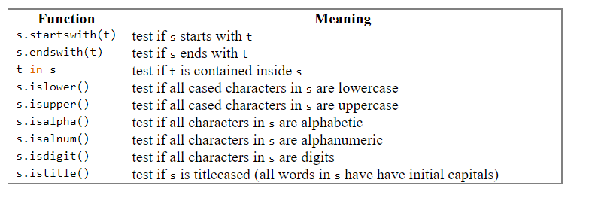
In particular, we want to find bigrams that occur more often than we would expect based on the frequency of individual words. The collocations() function does this for us
text4.collocations()

Slide 8
Gutenberg Corpus
NLTK includes a small selection of texts from the Project Gutenberg electronic text archive,
which contains some 25,000 free electronic books, hosted at http://www.gutenberg.org/.
We begin by getting the Python interpreter to load the NLTK package,
then ask to see nltk.corpus.gutenberg.fileids(), the file identifiers in this corpus
>>> import nltk >>> nltk.corpus.gutenberg.fileids()

Slide 9
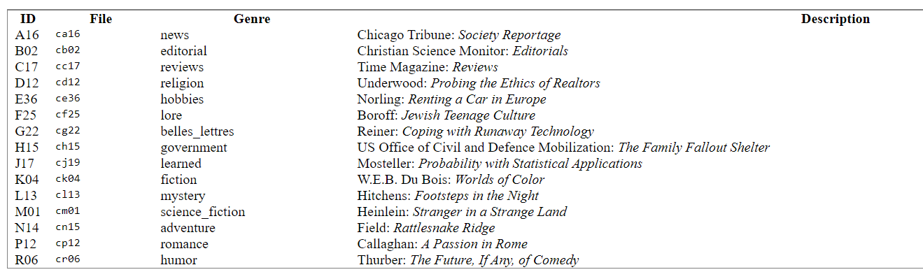
>>> from nltk.corpus import brown
>>> brown.categories()
['adventure', 'belles_lettres', 'editorial', 'fiction', 'government', 'hobbies', 'humor', 'learned', 'lore', 'mystery', 'news', 'religion', 'reviews', 'romance', 'science_fiction’]
>>> brown.words(categories='news’)
['The', 'Fulton', 'County', 'Grand', 'Jury', 'said', ...]
>>> brown.words(fileids=['cg22']) ['Does', 'our', 'society', 'have', 'a', 'runaway', ',', ...]
>>> brown.sents(categories=['news', 'editorial', 'reviews']) [['The', 'Fulton', 'County'...], ['The', 'jury', 'further'...], ...]

Slide 10
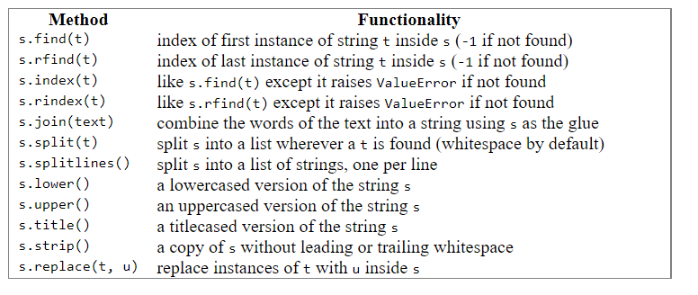

Slide 11
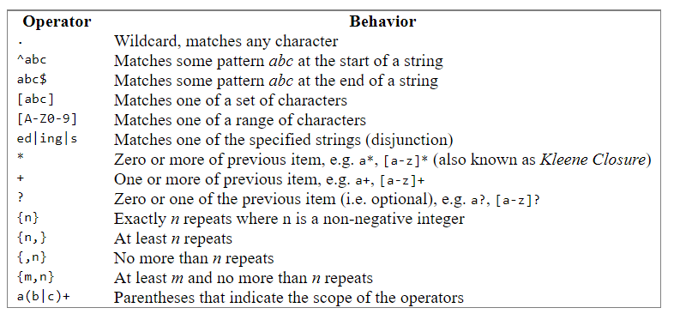

Slide 12
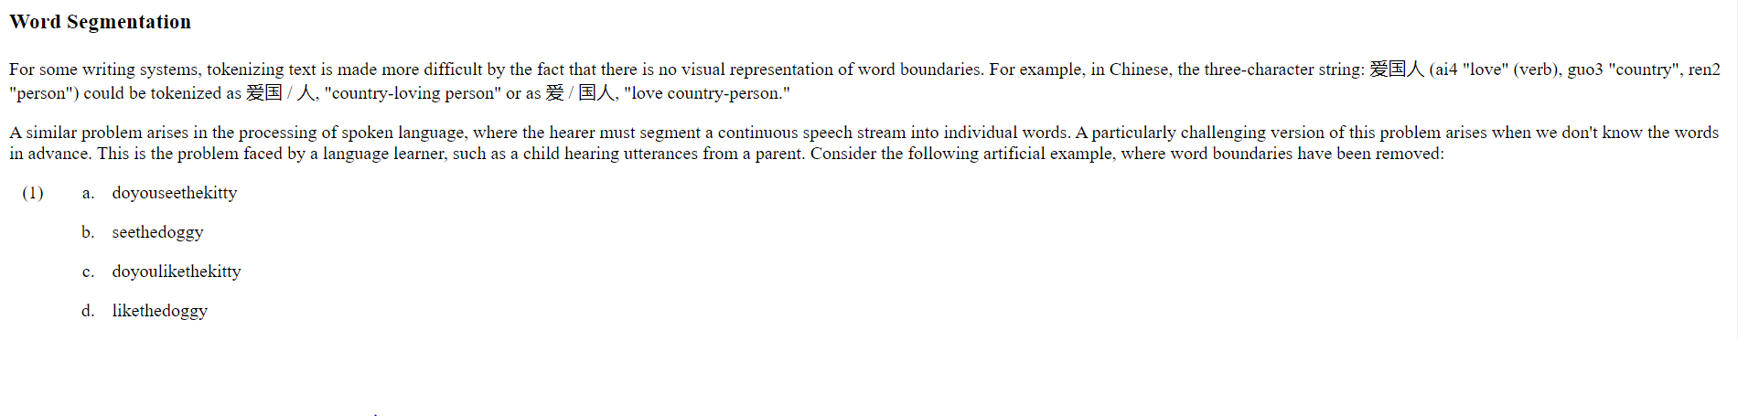
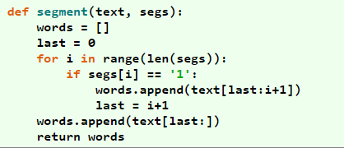

Slide 13
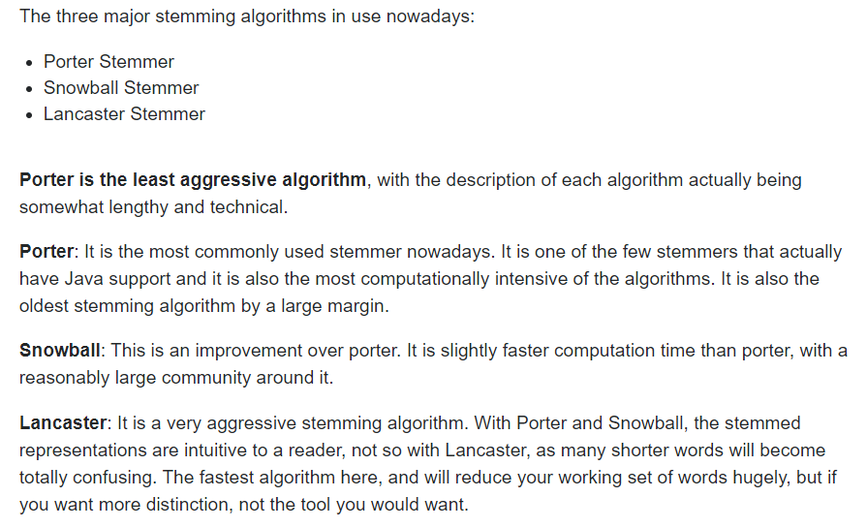

Slide 14
Word Embeddings
As it turns out, many Machine Learning algorithms and almost all Deep Learning Architectures are incapable of processing strings or plain text in their raw form. They require numbers as inputs to perform any sort of job, be it classification, regression etc. in broad terms. And with the huge amount of data that is present in the text format, it is imperative to extract knowledge out of it and build applications. Some real world applications of text applications are – sentiment analysis of reviews by Amazon etc., document or news classification or clustering by Google etc.
Let us now define Word Embeddings formally. A Word Embedding format generally tries to map a word using a dictionary to a vector. Let us break this sentence down into finer details to have a clear view.
Take a look at this example – sentence=” Word Embeddings are Word converted into numbers ”
A word in this sentence may be “Embeddings” or “numbers ” etc.
A dictionary may be the list of all unique words in the sentence. So, a dictionary may look like – [‘Word’,’Embeddings’,’are’,’Converted’,’into’,’numbers’]
A vector representation of a word may be a one-hot encoded vector where 1 stands for the position where the word exists and 0 everywhere else. The vector representation of “numbers” in this format according to the above dictionary is [0,0,0,0,0,1] and of converted is[0,0,0,1,0,0].

Slide 15
types of Word Embeddings
Frequency based Embedding
Prediction based Embedding

Slide 16
There are generally three types of vectors that we encounter under this category.
Count Vector
TF-IDF Vector
Co-Occurrence Vector

Slide 17
Count Vector
Consider a Corpus C of D documents {d1,d2…..dD} and N unique tokens extracted out of the corpus C. The N tokens will form our dictionary and the size of the Count Vector matrix M will be given by D X N. Each row in the matrix M contains the frequency of tokens in document D(i).
Let us understand this using a simple example.
D1: He is a lazy boy. She is also lazy.
D2: Neeraj is a lazy person.
The dictionary created may be a list of unique tokens(words) in the corpus
=[‘He’,’She’,’lazy’,’boy’,’Neeraj’,’person’]
Here, D=2, N=6
The count matrix M of size 2 X 6 will be represented as –

Slide 18
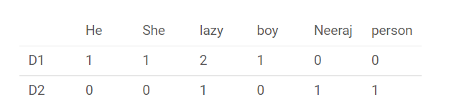
Now, a column can also be understood as word vector for the corresponding word in the matrix M. For example, the word vector for ‘lazy’ in the above matrix is [2,1] and so on.Here, the rows correspond to the documents in the corpus and the columns correspond to the tokens in the dictionary. The second row in the above matrix may be read as – D2 contains ‘lazy’: once, ‘Neeraj’: once and ‘person’ once.
Now there may be quite a few variations while preparing the above matrix M. The variations will be generally in-
The way dictionary is prepared. Why? Because in real world applications we might have a corpus which contains millions of documents. And with millions of document, we can extract hundreds of millions of unique words. So basically, the matrix that will be prepared like above will be a very sparse one and inefficient for any computation. So an alternative to using every unique word as a dictionary element would be to pick say top 10,000 words based on frequency and then prepare a dictionary.
The way count is taken for each word. We may either take the frequency (number of times a word has appeared in the document) or the presence(has the word appeared in the document?) to be the entry in the count matrix M. But generally, frequency method is preferred over the latter.
Below is a representational image of the matrix M for easy understanding.

Slide 19
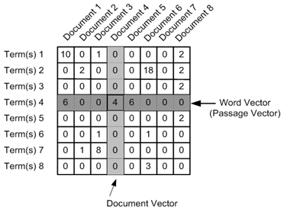

Slide 20
from sklearn.feature_extraction.text import CountVectorizer
document = [“one people help two",
"Two people help Four peoples",
"Each people helps many other peoples at longerrun"]
# Create a Vectorizer Object
vectorizer = CountVectorizer()
vectorizer.fit(document)
# Printing the identified Unique words along with their indices
print("Vocabulary: ", vectorizer.vocabulary_)
# Encode the Document
vector = vectorizer.transform(document)
# Summarizing the Encoded Texts
print("Encoded Document is:")
print(vector.toarray())

Slide 21
TF-IDF vectorization
This is another method which is based on the frequency method but it is different to the count vectorization in the sense that it takes into account not just the occurrence of a word in a single document but in the entire corpus.
This is another method which is based on the frequency method but it is different to the count vectorization in the sense that it takes into account not just the occurrence of a word in a single document but in the entire corpus. So, what is the rationale behind this? Let us try to understand.
Common words like ‘is’, ‘the’, ‘a’ etc. tend to appear quite frequently in comparison to the words which are important to a document. For example, a document A on Lionel Messi is going to contain more occurences of the word “Messi” in comparison to other documents. But common words like “the” etc. are also going to be present in higher frequency in almost every document.
Ideally, what we would want is to down weight the common words occurring in almost all documents and give more importance to words that appear in a subset of documents.
TF-IDF works by penalising these common words by assigning them lower weights while giving importance to words like Messi in a particular document

Slide 22
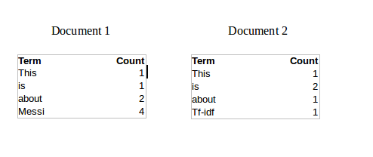
Consider the below sample table which gives the count of terms(tokens/words) in two documents.

Slide 23
Now, let us define a few terms related to TF-IDF.
TF = (Number of times term t appears in a document)/(Number of terms in the document)
So, TF(This,Document1) = 1/8
TF(This, Document2)=1/5
It denotes the contribution of the word to the document i.e words relevant to the document should be frequent. eg: A document about Messi should contain the word ‘Messi’ in large number.
IDF = log(N/n), where, N is the number of documents and n is the number of documents a term t has appeared in.
where N is the number of documents and n is the number of documents a term t has appeared in.
So, IDF(This) = log(2/2) = 0.
So, how do we explain the reasoning behind IDF? Ideally, if a word has appeared in all the document, then probably that word is not relevant to a particular document. But if it has appeared in a subset of documents then probably the word is of some relevance to the documents it is present in.
Let us compute IDF for the word ‘Messi’.
IDF(Messi) = log(2/1) = 0.301.
Now, let us compare the TF-IDF for a common word ‘This’ and a word ‘Messi’ which seems to be of relevance to Document 1.
TF-IDF(This,Document1) = (1/8) * (0) = 0
TF-IDF(This, Document2) = (1/5) * (0) = 0
TF-IDF(Messi, Document1) = (4/8)*0.301 = 0.15
As, you can see for Document1 , TF-IDF method heavily penalises the word ‘This’ but assigns greater weight to ‘Messi’. So, this may be understood as ‘Messi’ is an important word for Document1 from the context of the entire corpus.

Slide 24
# import required module
from sklearn.feature_extraction.text import TfidfVectorizer
# assign documents
d0 = 'Geeks for geeks'
d1 = 'Geeks'
d2 = 'r2j'
# merge documents into a single corpus
string = [d0, d1, d2]
# create object
tfidf = TfidfVectorizer()
# get tf-df values
result = tfidf.fit_transform(string)
# get idf values
print('\nidf values:')
for ele1, ele2 in zip(tfidf.get_feature_names(), tfidf.idf_):
print(ele1, ':', ele2)

Slide 25
# get indexing
print('\nWord indexes:')
print(tfidf.vocabulary_)
# display tf-idf values
print('\ntf-idf value:')
print(result)
# in matrix form
print('\ntf-idf values in matrix form:')
print(result.toarray())

Slide 26
Co-Occurrence Matrix with a fixed context window
The big idea – Similar words tend to occur together and will have similar context for example – Apple is a fruit. Mango is a fruit.
Apple and mango tend to have a similar context i.e fruit.
Before I dive into the details of how a co-occurrence matrix is constructed, there are two concepts that need to be clarified – Co-Occurrence and Context Window.
Co-occurrence – For a given corpus, the co-occurrence of a pair of words say w1 and w2 is the number of times they have appeared together in a Context Window.
Context Window – Context window is specified by a number and the direction. So what does a context window of 2 (around)

Slide 27
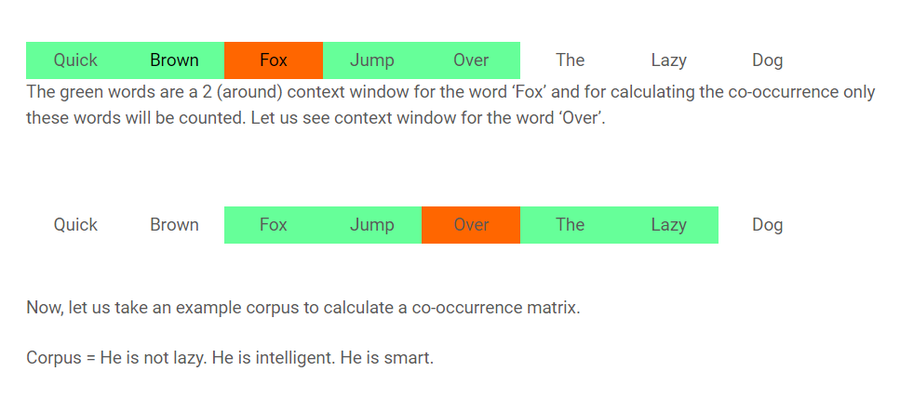

Slide 28
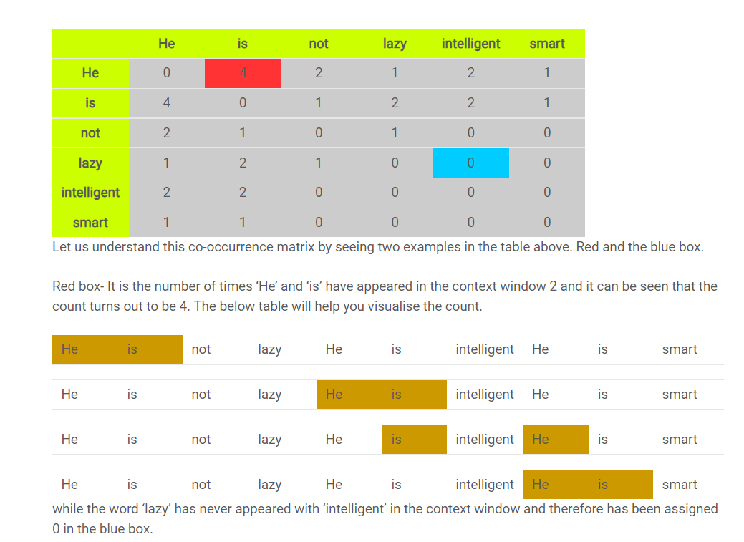

Slide 29
import numpy as np
import nltk
from nltk import bigrams
import itertools
import pandas as pd
def generate_co_occurrence_matrix(corpus):
vocab = set(corpus)
vocab = list(vocab)
vocab_index = {word: i for i, word in enumerate(vocab)}
# Create bigrams from all words in corpus
bi_grams = list(bigrams(corpus))
# Frequency distribution of bigrams ((word1, word2), num_occurrences)
bigram_freq = nltk.FreqDist(bi_grams).most_common(len(bi_grams))
# Initialise co-occurrence matrix
# co_occurrence_matrix[current][previous]
co_occurrence_matrix = np.zeros((len(vocab), len(vocab)))
# Loop through the bigrams taking the current and previous word,
# and the number of occurrences of the bigram.
for bigram in bigram_freq:
current = bigram[0][1]
previous = bigram[0][0]
count = bigram[1]
pos_current = vocab_index[current]
pos_previous = vocab_index[previous]
co_occurrence_matrix[pos_current][pos_previous] = count
co_occurrence_matrix = np.matrix(co_occurrence_matrix)
# return the matrix and the index
return co_occurrence_matrix, vocab_index

Slide 30
text_data = [['Where', 'Python', 'is', 'used'],
['What', 'is', 'Python' 'used', 'in'],
['Why', 'Python', 'is', 'best'],
['What', 'companies', 'use', 'Python']]
# Create one list using many lists
data = list(itertools.chain.from_iterable(text_data))
matrix, vocab_index = generate_co_occurrence_matrix(data)
data_matrix = pd.DataFrame(matrix, index=vocab_index,
columns=vocab_index)
print(data_matrix)

Slide 31
BAG OF WORD
Bag of words (BOW) is a technique to extract features from the text for Natural Language Processing.
The bag of word model focuses on the word count to represent a sentence. So, the order of the words in a sentence is not considered under the BOW model.
The steps involved in creating the BOW model for a piece of text are as follows:
Tokenize the text and store the tokens in a list.
Create a vocabulary out of the tokens.
Count the number of occurrences of tokens in each sentence and store the count.
Create a bag of words model by converting the text into vectors with count of each word from the vocabulary.

Slide 32
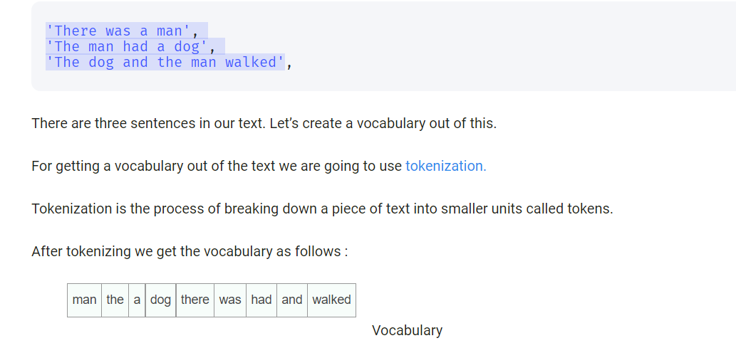

Slide 33
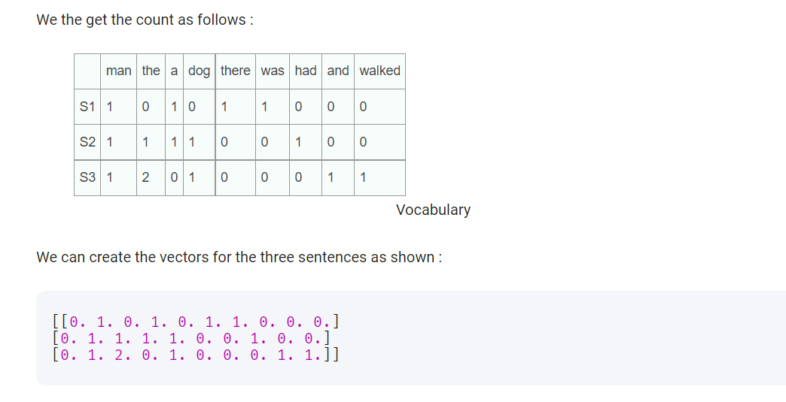

Slide 34
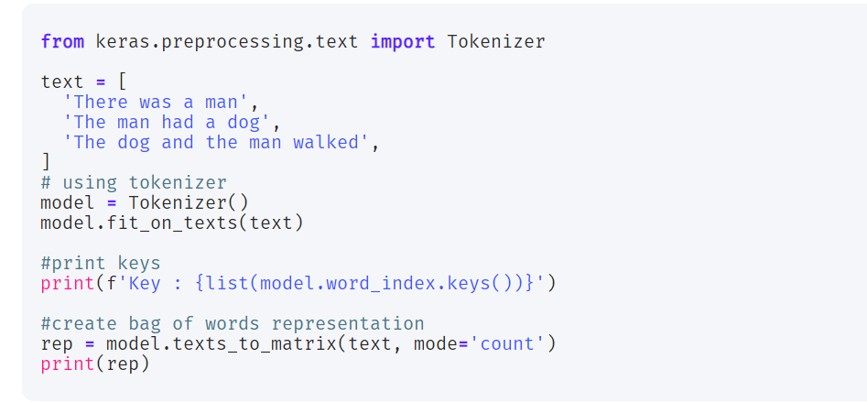

Slide 35
N-Grams
N-Grams is an important concept to understand in text analytics. Essentially, N-Grams is a set of 1 or more consecutive sequence of items that occur next to each other. As mentioned above, N is a numerical value that implies the n items of sequence of text.
When we type text in a search engine, we can see the probabilistic model of the search engine starts predicting the next set of words based on the context. This is known as the Autocomplete feature of the search engines.
N-Grams allows us to build this text mining forecasting model.
N-Grams allows us to predict the next words of a text

Slide 36
N-Grams allows us to predict the next words of a text
As an instance, if the sentence is “FinTechExplained is a publication”, then:
1-Gram would be: FinTechExplained, is, a, publication
2-Gram would be: FinTechExplained is, is a, a publication
3-Gram would be: FinTechExplained is a, is a publication

Slide 37
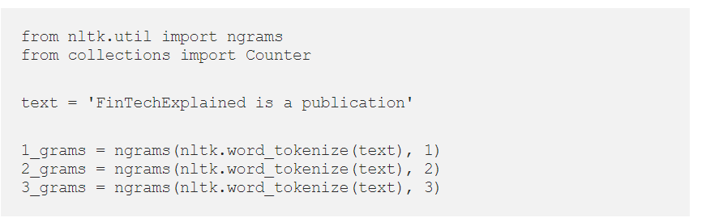

Slide 38
POS-TAGGING
POS tags give a large amount of information about a word and its neighbors. Their applications can be found in various tasks such as information retrieval, parsing, Text to Speech (TTS) applications, information extraction, linguistic research for corpora. They are also used as an intermediate step for higher-level NLP tasks such as parsing, semantics analysis, translation, and many more, which makes POS tagging a necessary function for advanced NLP applications.

Slide 39
Stochastic (Probabilistic) tagging:
A stochastic approach includes frequency, probability or statistics. The simplest stochastic approach finds out the most frequently used tag for a specific word in the annotated training data and uses this information to tag that word in the unannotated text. But sometimes this approach comes up with sequences of tags for sentences that are not acceptable according to the grammar rules of a language. One such approach is to calculate the probabilities of various tag sequences that are possible for a sentence and assign the POS tags from the sequence with the highest probability. Hidden Markov Models (HMMs) are probabilistic approaches to assign a POS Tag.

Slide 40
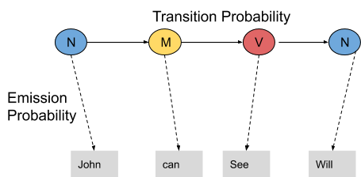
POS tagging with Hidden Markov Model

Slide 41
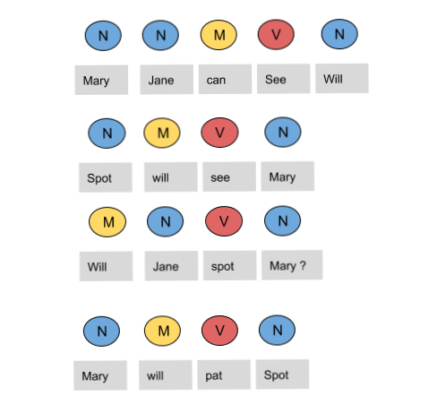

Slide 42
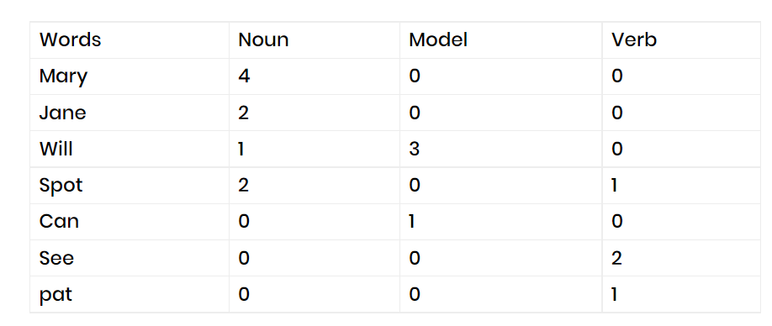

Slide 43
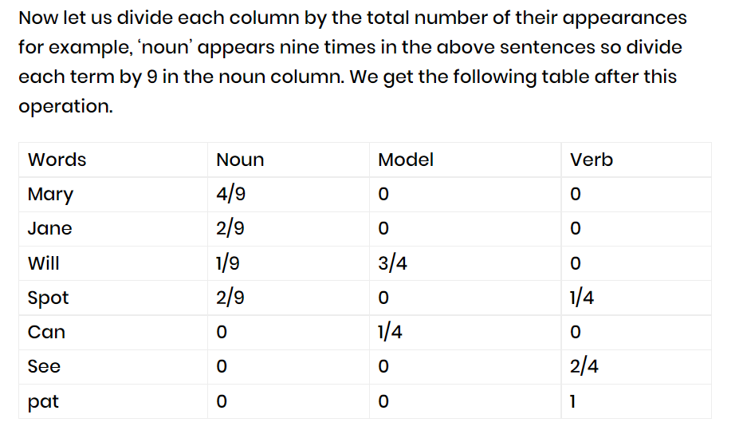

Slide 44
From the above table, we infer that
The probability that Mary is Noun = 4/9
The probability that Mary is Model = 0
The probability that Will is Noun = 1/9
The probability that Will is Model = 3/4
In a similar manner, you can figure out the rest of the probabilities. These are the emission probabilities.

Slide 45
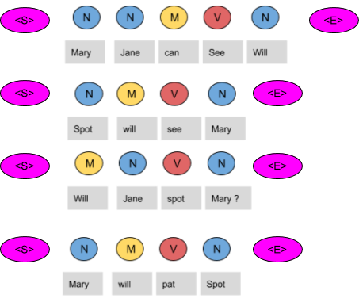
transition probabilities

Slide 46
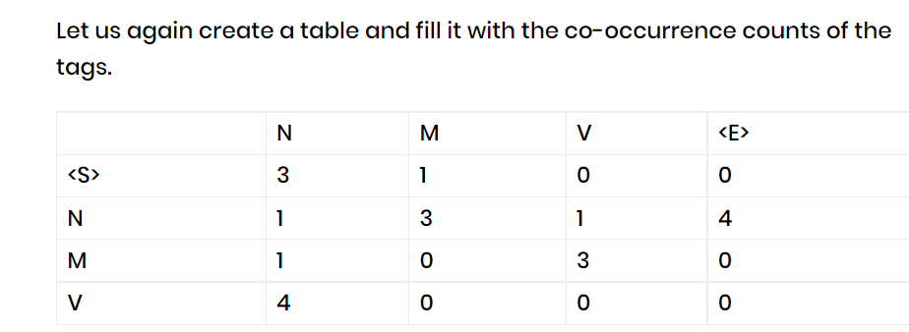
In the above figure, we can see that the <S> tag is followed by the N tag three times, thus the first entry is 3.The model tag follows the <S> just once, thus the second entry is 1. In a similar manner, the rest of the table is filled.
Next, we divide each term in a row of the table by the total number of co-occurrences of the tag in consideration, for example, The Model tag is followed by any other tag four times as shown below, thus we divide each element in the third row by four.

Slide 47
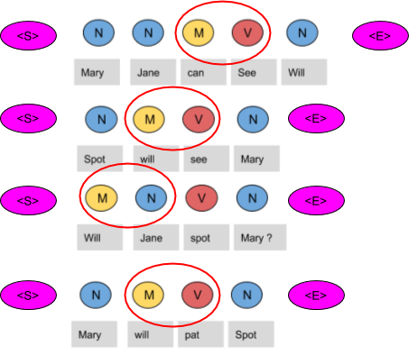

Slide 48
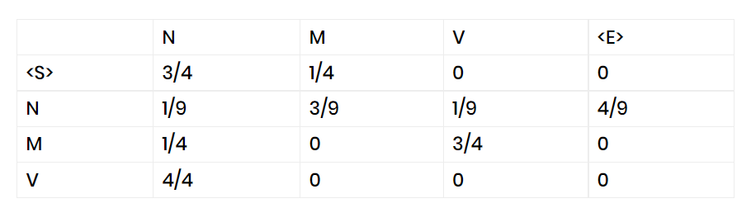
Will can spot Mary’ be tagged as-
Will as a model
Can as a verb
Spot as a noun
Mary as a noun
Now calculate the probability of this sequence being correct in the following manner.

Slide 49
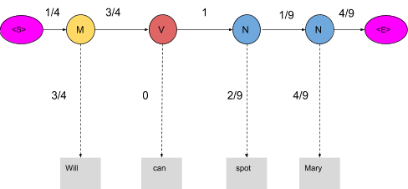

Slide 50
The probability of the tag Model (M) comes after the tag <S> is ¼ as seen in the table. Also, the probability that the word Will is a Model is 3/4. In the same manner, we calculate each and every probability in the graph. Now the product of these probabilities is the likelihood that this sequence is right. Since the tags are not correct, the product is zero.
1/4*3/4*3/4*0*1*2/9*1/9*4/9*4/9=0
When these words are correctly tagged, we get a probability greater than zero as shown below

Slide 51
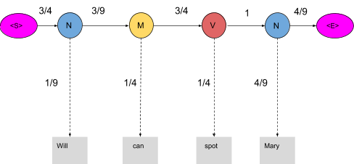
Calculating the product of these terms we get,
3/4*1/9*3/9*1/4*3/4*1/4*1*4/9*4/9=0.00025720164
<S>→N→M→N→N→<E> =3/4*1/9*3/9*1/4*1/4*2/9*1/9*4/9*4/9=0.00000846754
<S>→N→M→N→V→<E>=3/4*1/9*3/9*1/4*3/4*1/4*1*4/9*4/9=0.00025720164

Slide 52
Optimizing HMM with Viterbi Algorithm
The Viterbi algorithm is a dynamic programmatical algo for finding the most likely sequence of hidden states—called the Viterbi path—that results in a sequence of observed events, especially in the context of (HMM).
we optimized the HMM and bought our calculations down from 81 to just two. Now we are going to further optimize the HMM by using the Viterbi algorithm. Let us use the same example we used before and apply the Viterbi algorithm to it

Slide 53
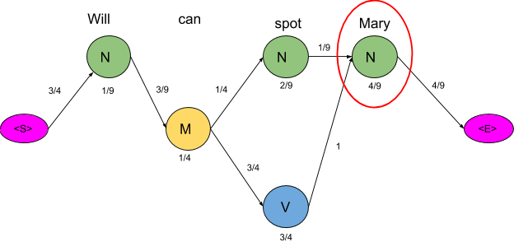

Slide 54
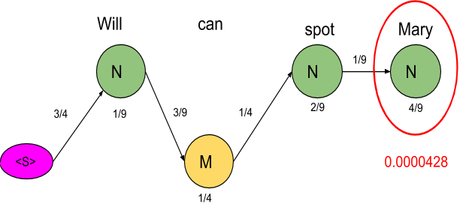
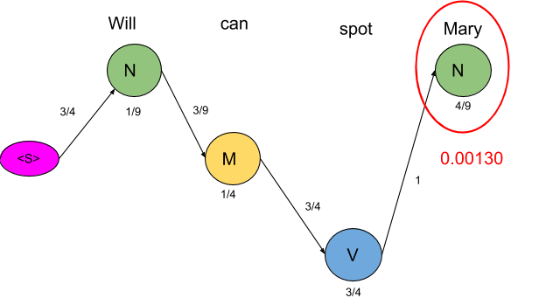
Now we are really concerned with the mini path having the lowest probability.

Slide 55
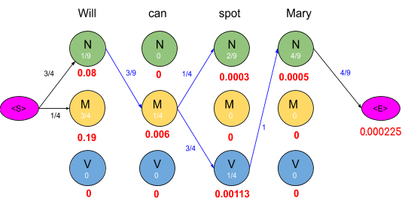

Slide 56
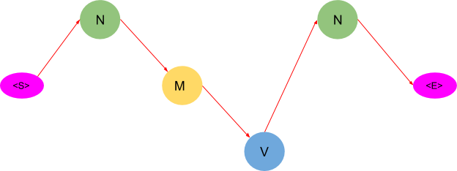
As you may have noticed, this algorithm returns only one path as compared to the previous method which suggested two paths. Thus by using this algorithm, we saved us a lot of computations.

Slide 57
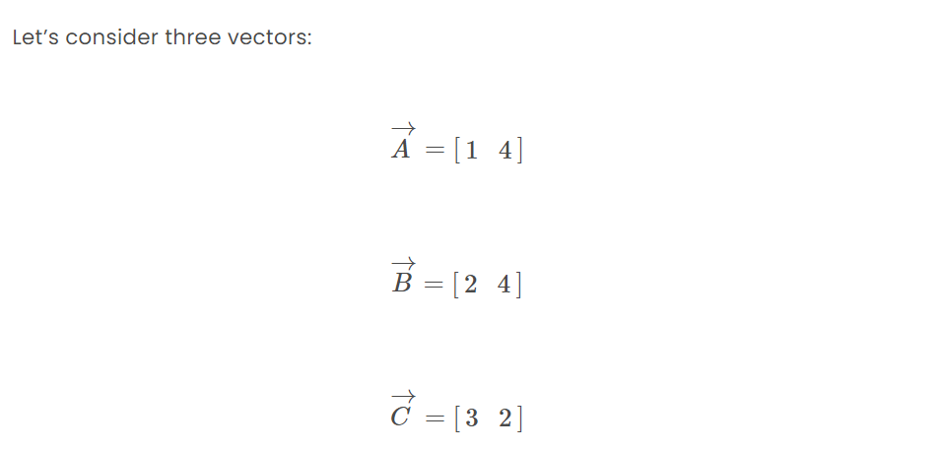
Cosine similarity
Cosine similarity is a measure of similarity between two non-zero vectors. It is calculated as the angle between these vectors (which is also the same as their inner product).
Well that sounded like a lot of technical information that may be new or difficult to the learner. We will break it down by part along with the detailed visualizations and examples here.

Slide 58
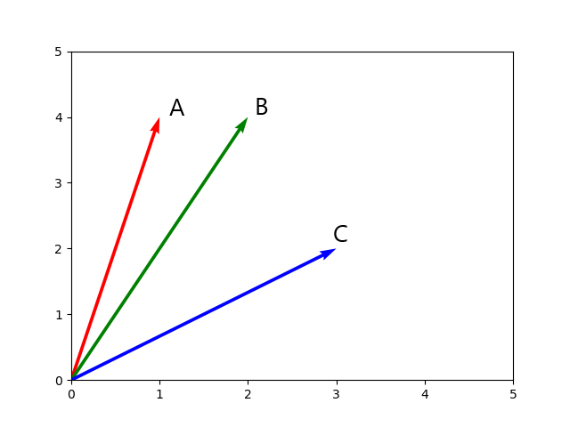
From the graph we can see that vector A is more similar to vector B than to vector C, for example.
But how were we able to tell? Well by just looking at it we see that they A and B are closer to each other than A to C. Mathematically speaking, the angle A0B is smaller than A0C.

Slide 59
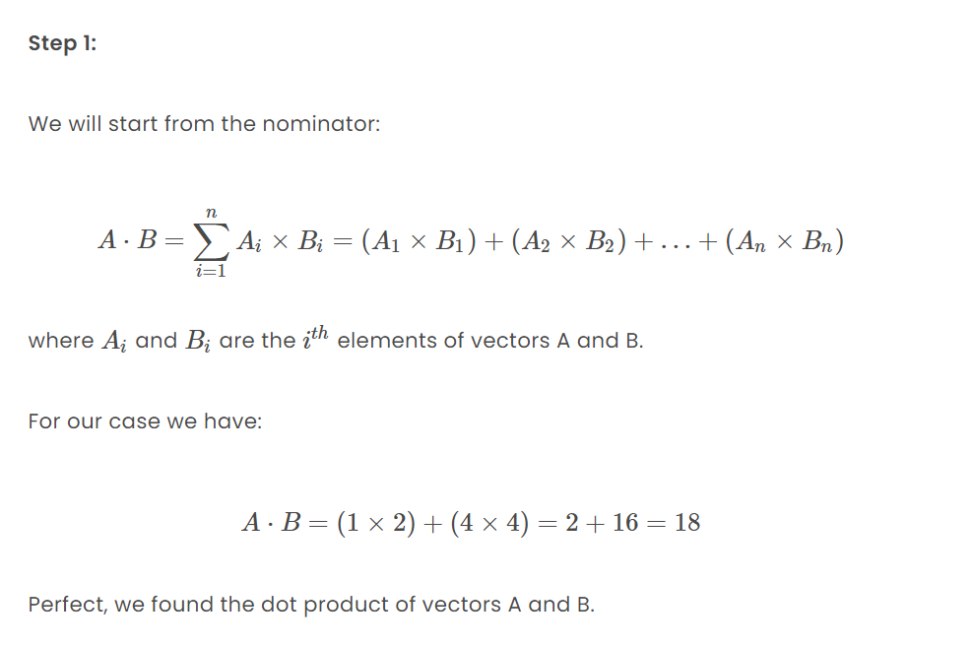

Slide 60
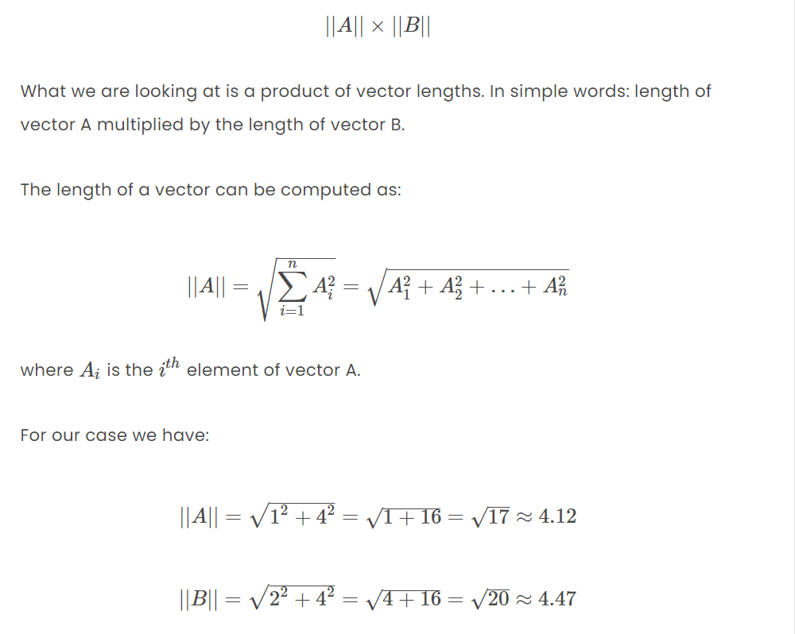
Step 2:
The next step is to work through the denominator:

Slide 61
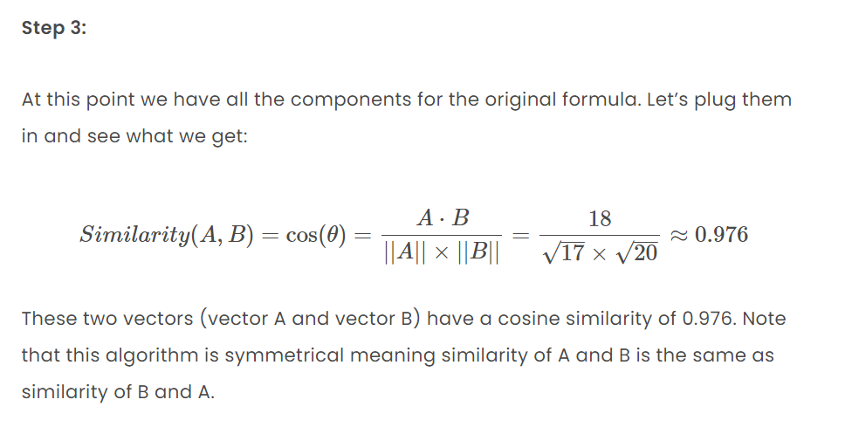

Slide 62
Named Entity
A named entity is basically a real-life object which has proper identification and can be denoted with a proper name. Named Entities can be a place, person, organization, time, object, or geographic entity.
For example, named entities would be Roger Federer, Honda city, Samsung Galaxy S10. Named entities are usually instances of entity instances. For example, Roger Federer is an instance of a Tennis Player/person, Honda City is an instance of a car and Samsung Galaxy S10 is an instance of a Mobile Phone.

Slide 63
Named Entity Recognition is the process of NLP which deals with identifying and classifying named entities. The raw and structured text is taken and named entities are classified into persons, organizations, places, money, time, etc. Basically, named entities are identified and segmented into various predefined classes.
NER systems are developed with various linguistic approaches, as well as statistical and machine learning methods. NER has many applications for project or business purposes.
NER model first identifies an entity and then categorizes the entity into the most suitable class. Some of the common types of Named Entities will be:

Slide 64
1. Organisations :
NASA, CERN, ISRO, etc
2. Places:
Mumbai, New York, Kolkata.
3. Money:
1 Billion Dollars, 50 Great Britain Pounds.
4. Date:
15th August 2020
5. Person:
Elon Musk, Richard Feynman, Subhas Chandra Bose.

Slide 65
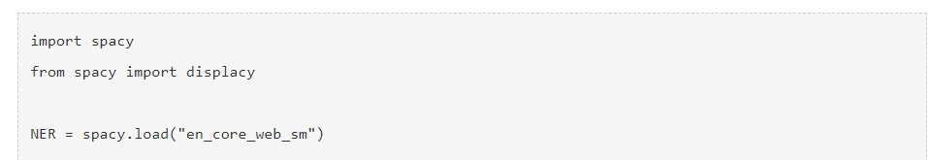
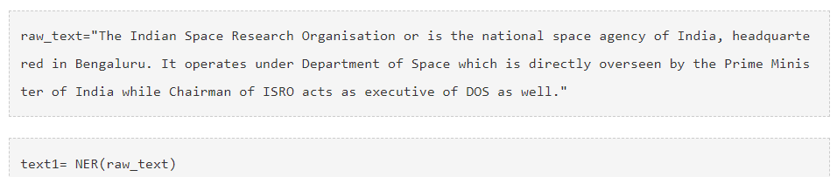

Slide 66
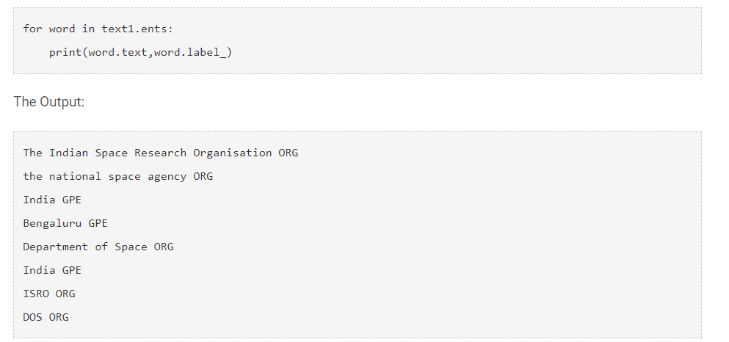

Slide 67
Page Rank Algorithm and Implementation
pageRank (PR) is an algorithm used by Google Search to rank websites in their search engine results
PageRank was named after Larry Page, one of the founders of Google.
PageRank is a way of measuring the importance of website pages. According to Google:
PageRank works by counting the number and quality of links to a page to determine a rough estimate of how important the website is
. The underlying assumption is that more important websites are likely to receive more links from other websites.
It is not the only algorithm used by Google to order search engine results, but it is the first algorithm that was used by the company, and it is the best-known.
The above centrality measure is not implemented for multi-graphs.

Slide 68
Assume a small universe of four web pages: A, B, C and D. Links from a page to itself, or multiple outbound links from one single page to another single page, are ignored. PageRank is initialized to the same value for all pages. In the original form of PageRank, the sum of PageRank over all pages was the total number of pages on the web at that time, so each page in this example would have an initial value of 1. However, later versions of PageRank, and the remainder of this section, assume a probability distribution between 0 and 1. Hence the initial value for each page in this example is 0.25.

Slide 69
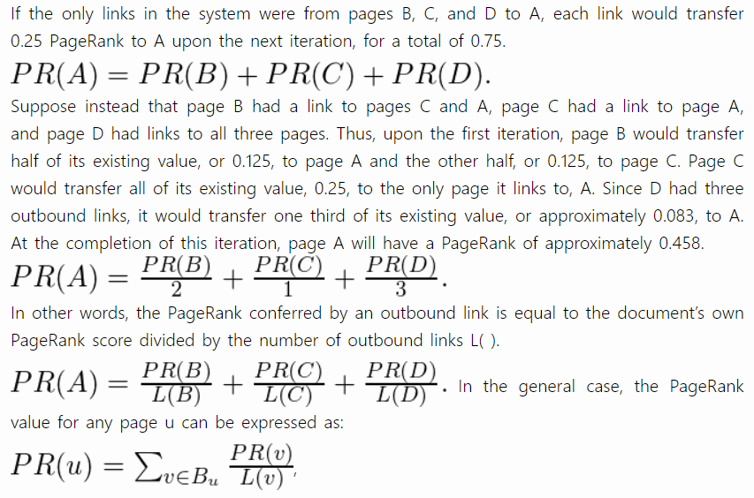

Slide 70
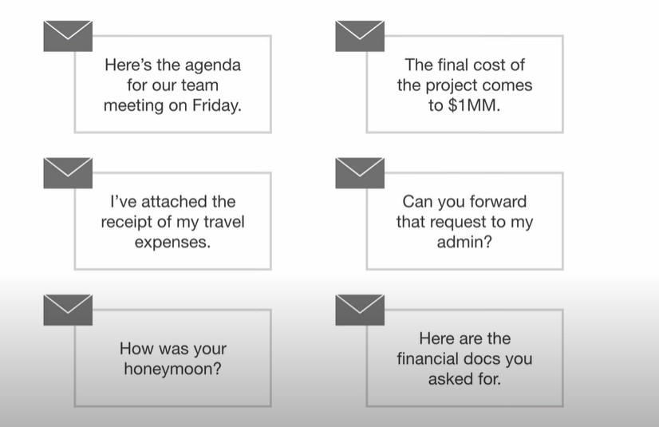
Topic modelling

Slide 71
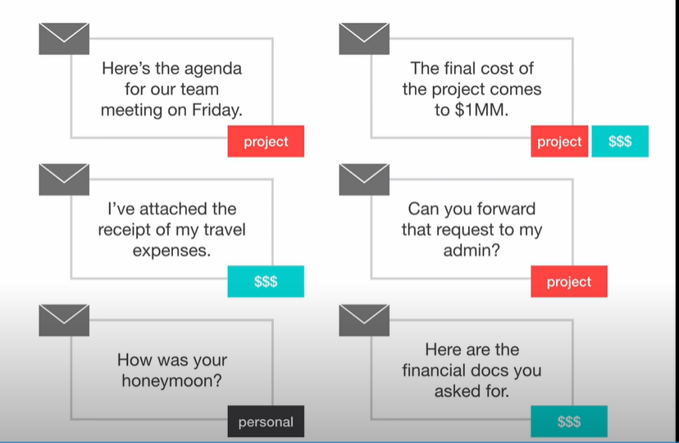

Slide 72
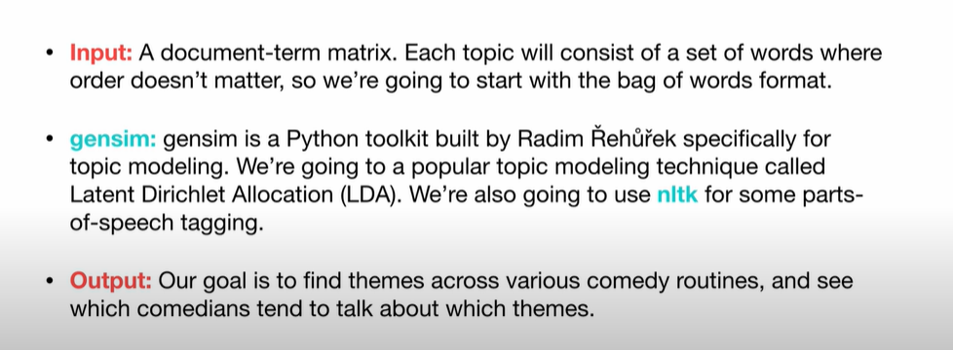

Slide 73
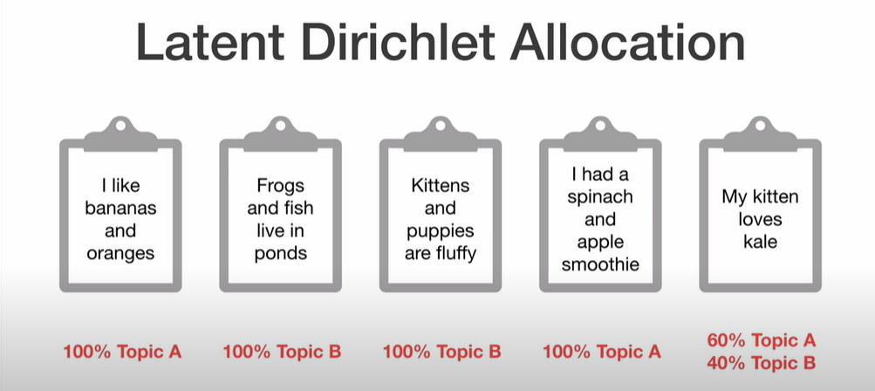

Slide 74
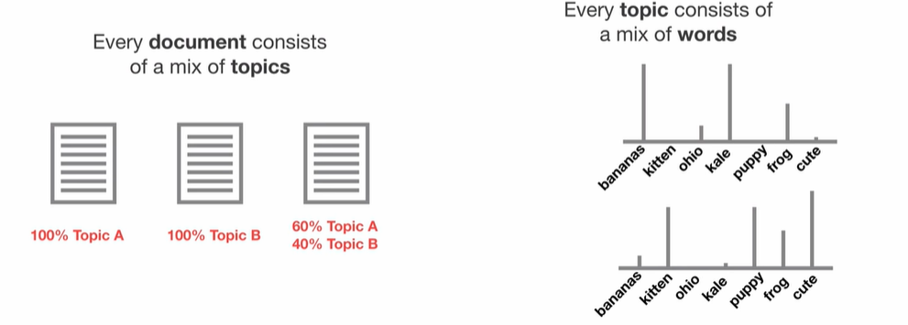

Slide 75
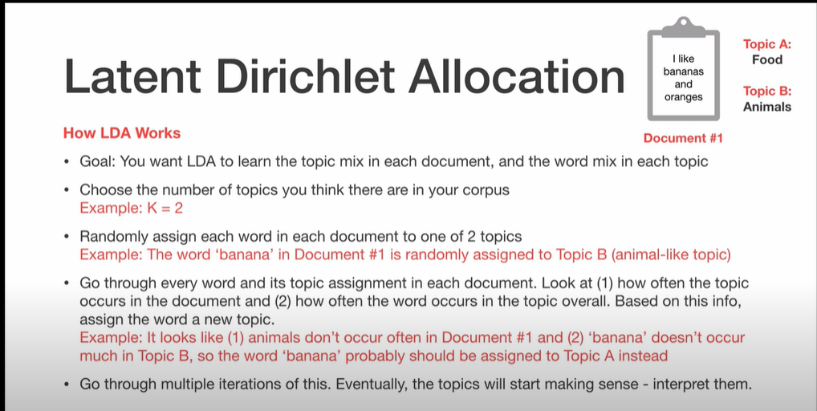

Slide 76
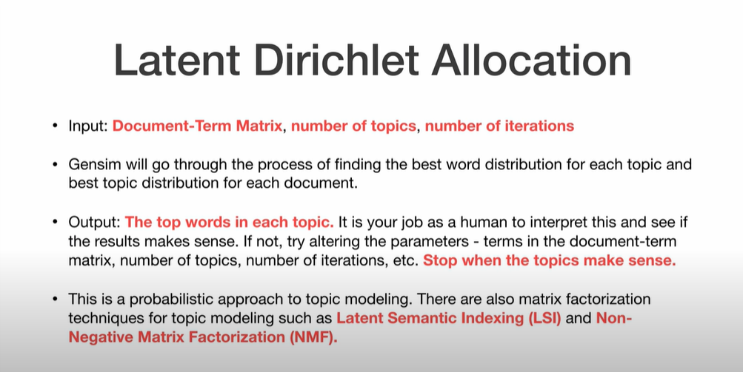
Latent Dirichlet Allocation
LDA is a generative probabilistic model that assumes each topic is a mixture over an underlying set of words, and each document is a mixture of over a set of topic probabilities

Slide 77
Parameters of LDA
Alpha parameter is Dirichlet prior concentration parameter that represents document-topic density — with a higher alpha, documents are assumed to be made up of more topics and result in more specific topic distribution per document.
Beta parameter is the same prior concentration parameter that represents topic-word density — with high beta, topics are assumed to made of up most of the words and result in a more specific word distribution per topic.

Slide 78
Loading data
Data cleaning
Exploratory analysis
Preparing data for LDA analysis
LDA model training
Analyzing LDA model results

Slide 79
coreference resolution
Coreference resolution (CR) is the task of finding all linguistic expressions (called mentions) in a given text that refer to the same real-world entity. After finding and grouping these mentions we can resolve them by replacing, as stated above, pronouns with noun phrases

Slide 80
import spacy
import neuralcoref
nlp = spacy.load('en_core_web_sm’)
neuralcoref.add_to_pipe(nlp)
doc = nlp('London is the capital of and largest city in England and the United Kingdom. It was founded by the Romans.’)
print(doc._.coref_clusters)

Slide 81
